Slide 1


Bunny7700
September 30, 2026

Slide 2

Outline
Executive Summary
Introduction
Methodology
Results
Conclusion
Appendix

Slide 3
Executive Summary
Methodologies
Data from the SpaceX REST API and Wikipedia web scraping, wrangled with Pandas into a binary landing Class
EDA with SQL and Seaborn; interactive Folium map and Plotly Dash dashboard
Classification with Logistic Regression, SVM, Decision Tree and KNN, tuned by GridSearchCV (cv=10)
Results
Landing success rose from 0% (2010-2013) to about 90% (2019); GTO is the hardest orbit (~52%)
Heavy payloads launched from CCAFS SLC 40 and KSC LC 39A mostly land
The tuned models reach 83.33% test accuracy (15 of 18 hold-out records); errors are false positives

Slide 4
Introduction
Background
SpaceX advertises Falcon 9 launches at $62M; other providers charge $165M+. Most of the saving comes from reusing the first stage
If we can predict whether the first stage lands, we can estimate the cost of a launch
Questions we answer
How do payload, orbit, launch site and flight number affect landing success?
How has the success rate changed over time?
Which classification model predicts the landing outcome best?

Slide 5

Section 1

Slide 6
Methodology
Executive Summary
Data collection: SpaceX REST API and Wikipedia web scraping
Data wrangling: filtered to Falcon 9, filled missing payload mass, created binary Class (1 = landed)
EDA: SQL queries and Seaborn visualizations
Interactive analytics: Folium launch-site map and Plotly Dash dashboard
Predictive analysis: StandardScaler, 80/20 split, GridSearchCV (cv=10) for LogReg, SVM, Tree and KNN; compare on test accuracy

Slide 7
Data Collection
SpaceX REST API: launch, rocket, payload, launchpad and core details returned as JSON
Web scraping: Falcon 9 launch table from Wikipedia parsed with BeautifulSoup
Both sources were normalised into Pandas DataFrames and exported to CSV
Key fields: flight number, date, booster version, payload mass, orbit, launch site, landing outcome, block, reused count, serial

Slide 8
Data Collection – SpaceX API
GET past launches from api.spacexdata.com/v4/launches/past and normalise the JSON
Resolve ID columns with follow-up calls: rocket, payloads, launchpad, cores
Keep single-core, single-payload Falcon 9 launches; apply the date cut-off
GitHub: https://github.com/Bunny7700/SpaceX-Falcon9-Landing-Prediction-Capstone
Request past launches (REST API)
Normalise JSON to DataFrame
Resolve rocket, payload, launchpad, core IDs
Filter Falcon 9, clean columns
Export CSV

Slide 9
Data Collection - Scraping
Request the Wikipedia "List of Falcon 9 and Falcon Heavy launches" page
Parse the HTML with BeautifulSoup and locate the launch tables
Extract headers and cells into a dictionary and build a DataFrame
GitHub: https://github.com/Bunny7700/SpaceX-Falcon9-Landing-Prediction-Capstone
HTTP GET Wikipedia page
Parse HTML (BeautifulSoup)
Locate launch tables
Extract headers and cell values
DataFrame and CSV

Slide 10
Data Wrangling
Counted launches per site and per orbit, and the number of each landing outcome
Grouped outcomes: bad (False Ocean, False RTLS, False ASDS, None ASDS, None None) vs. good landings
Created Class: 1 = first stage landed, 0 = did not land
Filled missing PayloadMass with the mean; LandingPad is null when no pad was used
Result: dataset_part_2.csv (about 90 launches)
GitHub: https://github.com/Bunny7700/SpaceX-Falcon9-Landing-Prediction-Capstone

Slide 11
EDA with Data Visualization
Scatter plots (catplot): Flight Number and Payload vs. Launch Site and Orbit, coloured by Class - shows how experience and load affect landing
Bar chart: success rate per orbit - shows which orbits are hardest
Line chart: yearly success rate - shows the learning trend
Feature engineering: 12 features; one-hot encoding of Orbit, LaunchSite, LandingPad, Serial; cast to float64
GitHub: https://github.com/Bunny7700/SpaceX-Falcon9-Landing-Prediction-Capstone

Slide 12
EDA with SQL
Loaded Spacex.csv into a SQLite table (SPACEXTBL) and queried it with %sql
Used DISTINCT, LIKE, SUM, AVG, MIN, MAX, GROUP BY, ORDER BY, BETWEEN and sub-queries
Ten questions: launch sites, NASA payload, F9 v1.1 average, first ground landing, drone-ship boosters, mission outcomes, maximum payload, 2015 failures, outcome ranking
GitHub: https://github.com/Bunny7700/SpaceX-Falcon9-Landing-Prediction-Capstone

Slide 13
Build an Interactive Map with Folium
Circles and labels mark each launch site on a world map
Marker clusters coloured green (success) and red (failure) show every launch record
Distance lines (PolyLine + MousePosition) measure the gap from a site to the nearest coastline, railway, highway and city
Why: to see where sites sit geographically and how close they are to logistics and to populated areas
GitHub: https://github.com/Bunny7700/SpaceX-Falcon9-Landing-Prediction-Capstone

Slide 14
Build a Dashboard with Plotly Dash
Drop-down selects a launch site (or All Sites) and drives a success pie chart
Range slider selects payload mass and drives a payload vs. outcome scatter plot coloured by booster version
Callbacks link the controls to the charts so the analysis updates instantly
Why: lets a viewer explore success by site and payload without editing code
GitHub: https://github.com/Bunny7700/SpaceX-Falcon9-Landing-Prediction-Capstone

Slide 15
Predictive Analysis (Classification)
Y = Class as a NumPy array; X standardised with StandardScaler
80/20 train/test split (random_state=2): 72 training and 18 test records
GridSearchCV (cv=10) tuned Logistic Regression, SVM, Decision Tree and KNN
Evaluated with test accuracy and confusion matrix; best model chosen on test accuracy
GitHub: https://github.com/Bunny7700/SpaceX-Falcon9-Landing-Prediction-Capstone
Standardise features
Train / test split 80/20
GridSearchCV cv=10 (4 models)
Score on test set
Confusion matrix and best model

Slide 16
Results
EDA results: success 0% (2010-13) to ~90% (2019); GTO hardest at ~52%; VLEO, LEO, SSO most reliable
Interactive analytics: Folium map and Plotly Dash dashboard screenshots (slides 35-41)
Predictive analysis: four tuned classifiers, 83.33% test accuracy
Innovative insight: an expected-cost model, cost = $62M x P(landing) + replacement cost x (1 - P(landing)), lets a bidder turn the classifier probability into a price estimate

Slide 17

Section 2

Slide 18
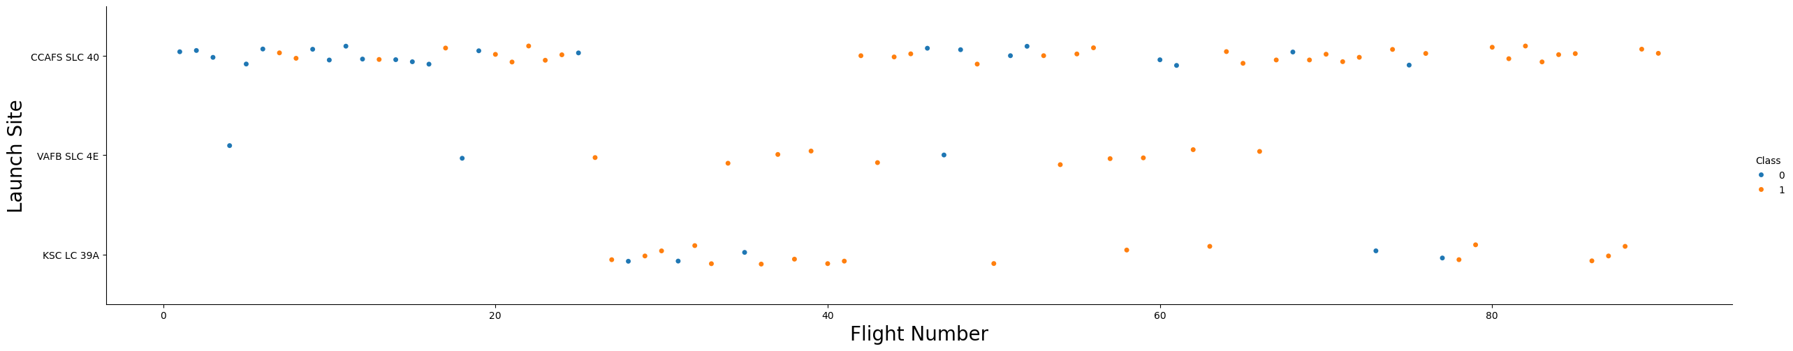
Flight Number vs. Launch Site
Failures (blue) cluster in the early flights at CCAFS SLC 40
As flight number grows, all sites show mostly successful (orange) landings
KSC LC 39A appears around flight 27 and is largely successful

Slide 19
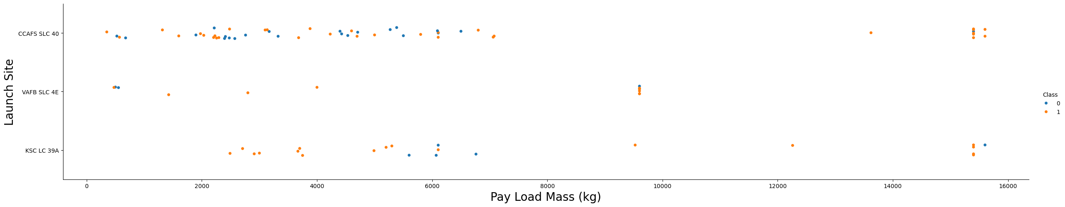
Payload vs. Launch Site
VAFB SLC 4E has no launches above ~10,000 kg
Payloads above 15,000 kg fly from CCAFS SLC 40 and KSC LC 39A and mostly land
Mid-range payloads (2,000-7,000 kg) show the most failures

Slide 20
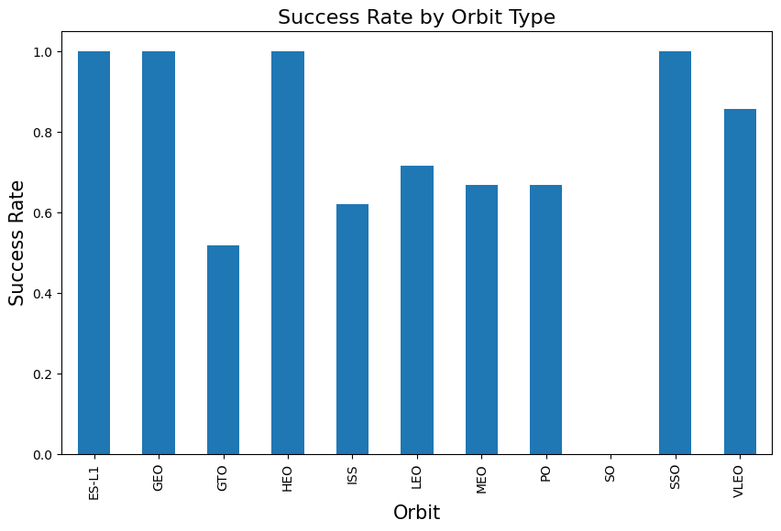
Success Rate vs. Orbit Type
Orbits with 100% success: ES-L1, GEO, HEO, SSO (small samples)
VLEO ~86%, LEO ~72%, MEO and PO ~67%, ISS ~62%
GTO ~52% is the hardest orbit; SO is 0% (one flight)

Slide 21
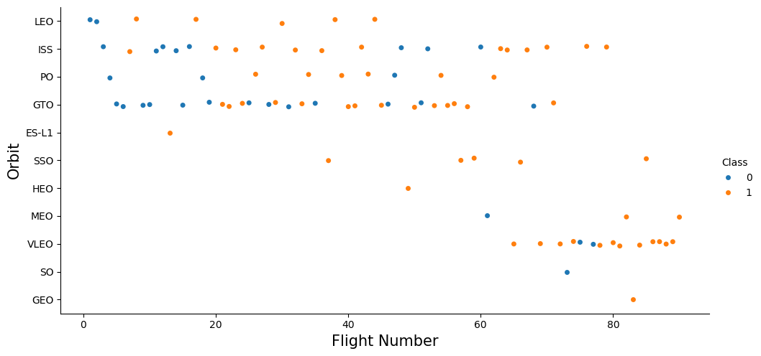
Flight Number vs. Orbit Type
In LEO, success grows with flight number
In GTO there is no clear relationship between flight number and outcome
The newest flights (65+) are mostly VLEO and succeed

Slide 22
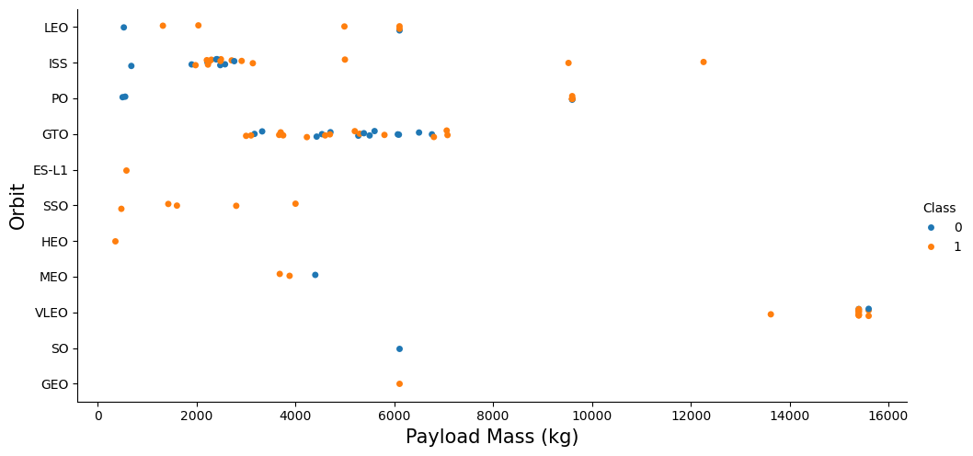
Payload vs. Orbit Type
Heavy payloads land well for Polar, LEO and ISS
GTO shows both outcomes at similar payloads, so payload alone cannot separate them
VLEO carries the heaviest payloads (~15,000 kg)

Slide 23
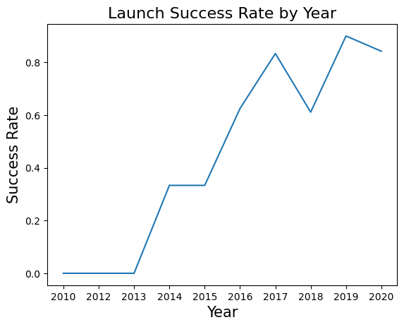
Launch Success Yearly Trend
2010-2013: 0%; 2014-2015: ~33%
2016-2017: rises to ~83%; 2018 dips to ~61%
2019 peaks at ~90%; 2020 is ~84%
Success climbed steadily 2013-2017 and stayed high: a clear learning curve

Slide 24
All Launch Site Names
Four unique launch sites; CCAFS LC-40 and CCAFS SLC-40 are the same Cape Canaveral pad written two ways.
SELECT DISTINCT Launch_Site FROM SPACEXTBL;
Launch_Site
CCAFS LC-40
VAFB SLC-4E
KSC LC-39A
CCAFS SLC-40

Slide 25
Launch Site Names Begin with 'CCA'
The first five launches were all from Cape Canaveral with light payloads to LEO / ISS.
SELECT * FROM SPACEXTBL WHERE Launch_Site LIKE 'CCA%' LIMIT 5;
Date | Booster | Site | Payload | Mass (kg) | Orbit
2010-06-04 | F9 v1.0 B0003 | CCAFS LC-40 | Dragon Qualification Unit | 0 | LEO
2010-12-08 | F9 v1.0 B0004 | CCAFS LC-40 | Dragon demo flight C1 | 0 | LEO (ISS)
2012-05-22 | F9 v1.0 B0005 | CCAFS LC-40 | Dragon demo flight C2 | 525 | LEO (ISS)
2012-10-08 | F9 v1.0 B0006 | CCAFS LC-40 | SpaceX CRS-1 | 500 | LEO (ISS)
2013-03-01 | F9 v1.0 B0007 | CCAFS LC-40 | SpaceX CRS-2 | 677 | LEO (ISS)

Slide 26
Total Payload Mass
Boosters launched for NASA (CRS) carried 48,213 kg in total.
SELECT SUM(PAYLOAD_MASS__KG_) AS Total_Payload_Mass FROM SPACEXTBL WHERE Customer LIKE 'NASA (CRS)%';
Total_Payload_Mass (kg)
48,213

Slide 27
Average Payload Mass by F9 v1.1
Booster version F9 v1.1 carried about 2,535 kg on average.
SELECT AVG(PAYLOAD_MASS__KG_) AS Average_Payload_Mass FROM SPACEXTBL WHERE Booster_Version LIKE 'F9 v1.1%';
Average_Payload_Mass (kg)
2,534.67

Slide 28
First Successful Ground Landing Date
The first successful ground-pad landing took place on 22 December 2015.
SELECT MIN(Date) AS First_Successful_Ground_Landing FROM SPACEXTBL WHERE Landing_Outcome LIKE '%Success%ground%';
First_Successful_Ground_Landing
2015-12-22

Slide 29
Successful Drone Ship Landing, Payload 4000-6000 kg
Four Full Thrust boosters landed on a drone ship with mid-weight payloads.
SELECT Booster_Version FROM SPACEXTBL WHERE Landing_Outcome = 'Success (drone ship)' AND PAYLOAD_MASS__KG_ BETWEEN 4000 AND 6000;
Booster_Version
F9 FT B1022
F9 FT B1026
F9 FT B1021.2
F9 FT B1031.2

Slide 30
Total Number of Successful and Failure Mission Outcomes
100 of 101 missions succeeded (98 + 1 with a trailing space + 1 payload status unclear); one failed in flight.
SELECT Mission_Outcome, COUNT(*) AS Count FROM SPACEXTBL GROUP BY Mission_Outcome;
Mission_Outcome | Count
Success | 98
Success (trailing space in data) | 1
Success (payload status unclear) | 1
Failure (in flight) | 1

Slide 31
Boosters Carried Maximum Payload
All 12 boosters that carried the maximum payload are Block 5 (F9 B5).
SELECT Booster_Version FROM SPACEXTBL WHERE PAYLOAD_MASS__KG_ = (SELECT MAX(PAYLOAD_MASS__KG_) FROM SPACEXTBL);
Booster_Version | Booster_Version | Booster_Version
F9 B5 B1048.4 | F9 B5 B1049.4 | F9 B5 B1051.3
F9 B5 B1056.4 | F9 B5 B1048.5 | F9 B5 B1051.4
F9 B5 B1049.5 | F9 B5 B1060.2 | F9 B5 B1058.3
F9 B5 B1051.6 | F9 B5 B1060.3 | F9 B5 B1049.7

Slide 32
2015 Launch Records
Both 2015 drone-ship landing failures (January and April) were launched from Cape Canaveral.
SELECT substr(Date,6,2) AS Month, Landing_Outcome, Booster_Version, Launch_Site FROM SPACEXTBL WHERE Landing_Outcome='Failure (drone ship)' AND substr(Date,0,5)='2015';
Month | Landing_Outcome | Booster_Version | Launch_Site
01 | Failure (drone ship) | F9 v1.1 B1012 | CCAFS LC-40
04 | Failure (drone ship) | F9 v1.1 B1015 | CCAFS LC-40

Slide 33
Rank Landing Outcomes Between 2010-06-04 and 2017-03-20
Most early flights made no landing attempt; drone-ship successes and failures were tied at five each.
SELECT Landing_Outcome, COUNT(*) AS Outcome_Count FROM SPACEXTBL WHERE Date BETWEEN '2010-06-04' AND '2017-03-20' GROUP BY Landing_Outcome ORDER BY Outcome_Count DESC;
Landing_Outcome | Count
No attempt | 10
Success (drone ship) | 5
Failure (drone ship) | 5
Success (ground pad) | 3
Controlled (ocean) | 3
Uncontrolled (ocean) | 2
Failure (parachute) | 2
Precluded (drone ship) | 1

Slide 34

Section 3

Slide 35
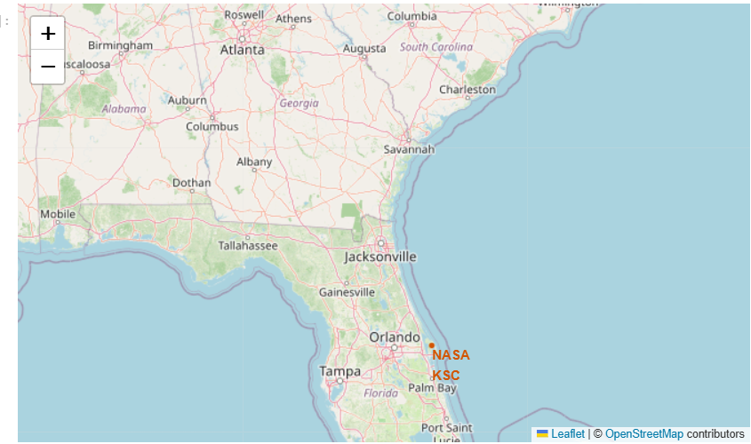
Folium Map: All Launch Sites
All launch sites are marked with a circle and label on a world map
Sites sit on the US coasts (Florida and California) at low latitude, close to the equator
Being near the equator adds Earth's rotational speed at launch; coastal sites let failed stages fall over the ocean
Paste Folium screenshot 1 here:
world map with all launch site markers

Slide 36
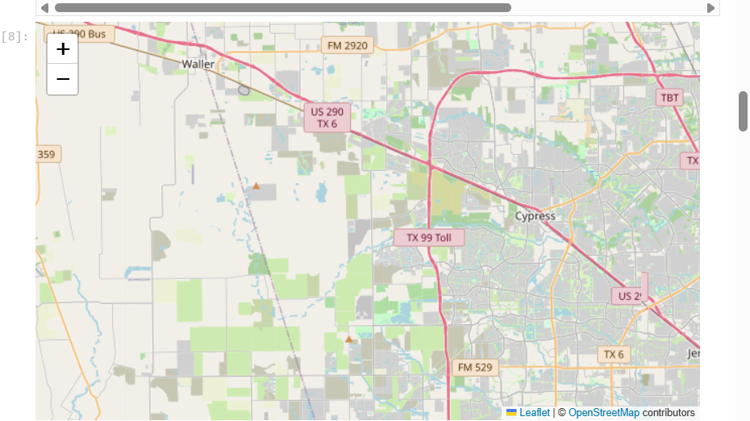
Folium Map: Launch Outcomes by Site
Marker clusters colour each launch record: green = success, red = failure
Compare the green / red mix per site to see which site has the best record
State which site has the most green markers (from your map)
Paste Folium screenshot 2 here:
colour-coded launch outcomes for each site

Slide 37
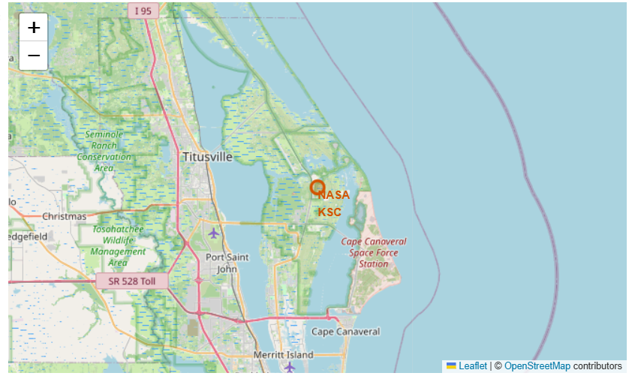
Folium Map: Distance to Proximities
Lines from a launch site to the nearest coastline, railway, highway and city
Fill in the measured distances (km) from your notebook
State whether sites are close to coast, railway and highway and far from cities (from your map)
Paste Folium screenshot 3 here:
distance lines to coast, railway, highway and city

Slide 38

Section 4

Slide 39
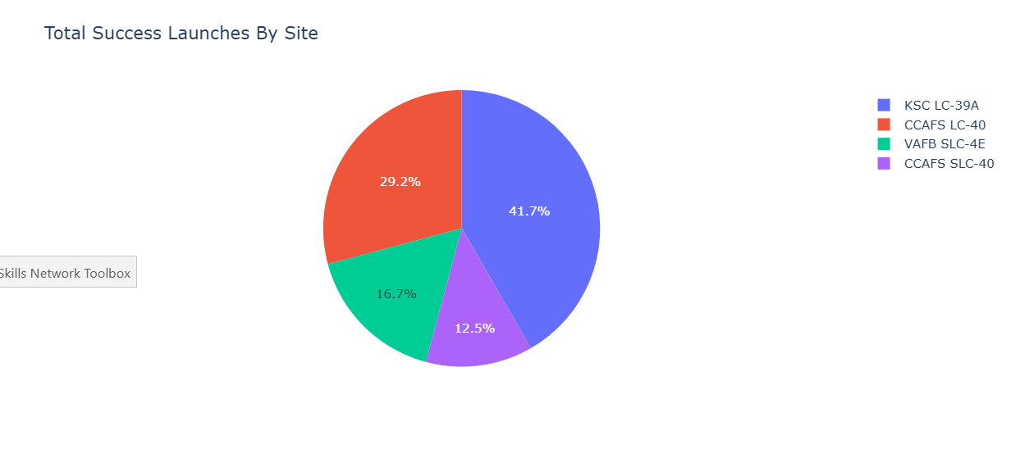
Dash: Launch Success Count by Site
Pie chart shows each site's share of all successful landings
Name the site with the largest share of successes : KSC LC = A39

Slide 40
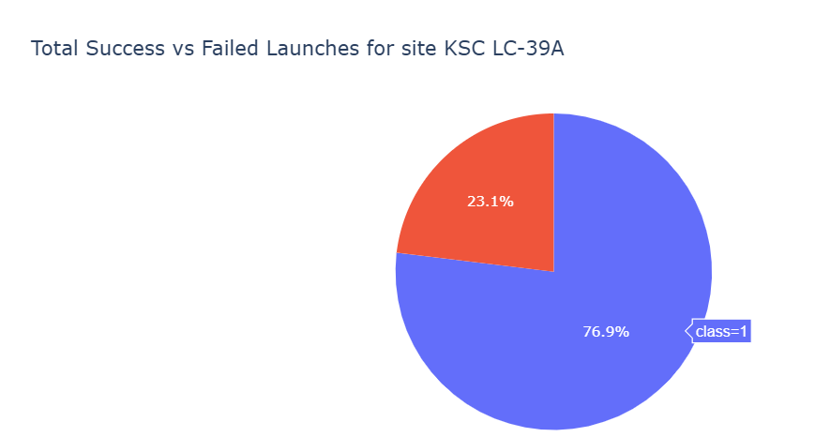
Dash: Site with Highest Success Ratio
Select the site with the highest success ratio to show its success / failure split
Report its success percentage (from your dashboard)
Paste Dashboard screenshot 2 here:
pie chart for the best-performing site

Slide 41
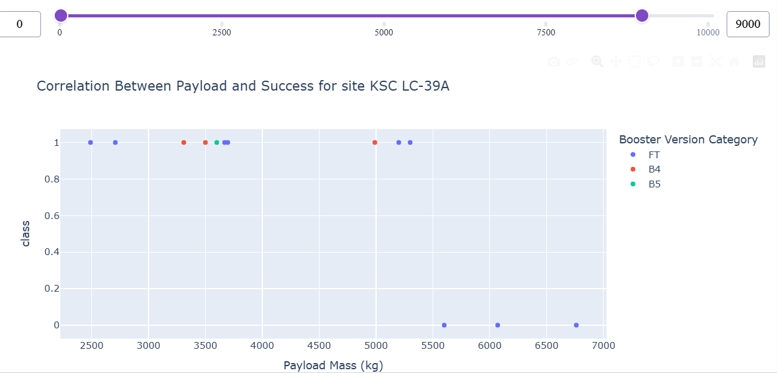
Dash: Payload vs. Launch Outcome
Scatter of payload against Class for all sites, coloured by booster version, filtered by the payload slider
Report the payload range and booster version with the highest success rate (from your dashboard)
Paste Dashboard screenshot 3 here:
payload vs. outcome scatter (two slider ranges)

Slide 42

Section 5

Slide 43
Classification Accuracy
All four tuned models score 83.33% on the 18-record test set (15 correct)
No model is clearly best; one prediction changes accuracy by 5.6 points
Logistic Regression is a reasonable pick: simplest and least prone to overfitting

Slide 44
Confusion Matrix
Best model shown: all four models give the same result on the test set
True positives 12, true negatives 3, false positives 3, false negatives 0
Every successful landing is found; the main error is false positives (a failed landing predicted as landed)
 | Predicted: did not land | Predicted: landed
True: did not land | TN = 3 | FP = 3
True: landed | FN = 0 | TP = 12

Slide 45
Conclusions
Landing success rose from 0% (2010-2013) to about 90% (2019) as SpaceX gained experience
GTO is the hardest orbit (~52%); VLEO, LEO and SSO are the most reliable
Heavy payloads launched from CCAFS SLC 40 and KSC LC 39A mostly land; VAFB SLC 4E flies no payload above ~10,000 kg
All launch sites are close to the coast, so failed stages fall over water
Classifiers predict a landing with about 83% accuracy, enough to support launch-cost estimates for a bidder
Next steps: more data, weather and reuse features, ensemble models

Slide 46
Appendix
GitHub: https://github.com/Bunny7700/SpaceX-Falcon9-Landing-Prediction-Capstone
GridSearchCV used for all four classifiers (example: SVM):
parameters = {'kernel': ('linear','rbf','poly','sigmoid'),
'C': np.logspace(-3, 3, 5),
'gamma': np.logspace(-3, 3, 5)}
svm_cv = GridSearchCV(SVC(), parameters, cv=10)
svm_cv.fit(X_train, Y_train)
print(svm_cv.best_params_, svm_cv.best_score_)
print('test accuracy:', svm_cv.score(X_test, Y_test))

